Slide 1

Team Members: Hadia Tariq Nawal Najam Wardah Najam Saria Kanwal Arooj Shahid Eman Amjad

Slide 2
DOMAIN MODEL

Slide 3
What is a Domain? “A domain is the area or field for which a system is developed.” Domain = what the system is about Examples: Banking system → domain is banking Hospital system → domain is healthcare Shopping website → domain is online shopping What is a Model? “A model is a simplified representation of a real-world system or concept.” Model = a simple version of something real Examples: A map → model of a city A diagram → model of a system A blueprint → model of a building

Slide 4
SIMPLE DEFINITION:
“A domain model is a conceptual representation of real-world entities, their attributes, and the relationships between them within a specific domain.”
OR
“A domain model helps us understand a system by showing its main objects and how they interact with each other.”
It shows:
Objects (like Sale, Payment)
Relationships (how they connect)
Attributes (data like date, amount)
It is NOT about software code, but about real-world understanding.

Slide 5
EXAMPLES:
2)Food Delivery System
Domain: Food Delivery
Model: Customer, Restaurant, Order
Explanation: Customers order food from restaurants
1) Banking System
Domain: Banking
Model: Customer, Account, Transaction
Explanation: Customer has accounts, and accounts record transactions.

Slide 6

Sample Up Artifact Influence
This is showing how software development progresses in an iteration (specifically Iteration 1).

Slide 7
What Domain Model SHOWS: Real-world objects (Sale, Payment) Their relationships Their basic data (date, price) What Domain Model DOES NOT SHOW: Software code Methods/functions Programming classes

Slide 8
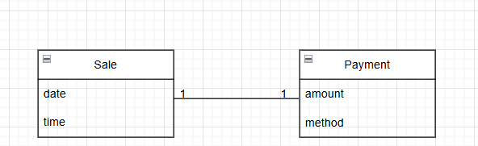
Sale And Payment Are Objects
A Sale Is Connected To Payment
Sale Has Date & Time
Payment Has Amount
This Is A Domain Model Diagram

Slide 9
Why We Use Domain Model?
Helps us understand the system
Improves communication
Makes software design easier later
Keeps real-world and software similar
This reduces confusion (called low representational gap)

Slide 10
Why called a domain model a visual dictionary?
A Domain Model is called a “visual dictionary” because it shows the meaning of terms and their relationships using pictures instead of only words.
A normal dictionary:
Gives meanings of words in text
Example: Sale = a transaction where goods are sold
A Domain Model (visual dictionary):
Shows meanings using diagrams
Shows how things are connected

Slide 11
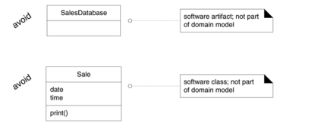
Domain model does not shows software artifacts and classes

Slide 12
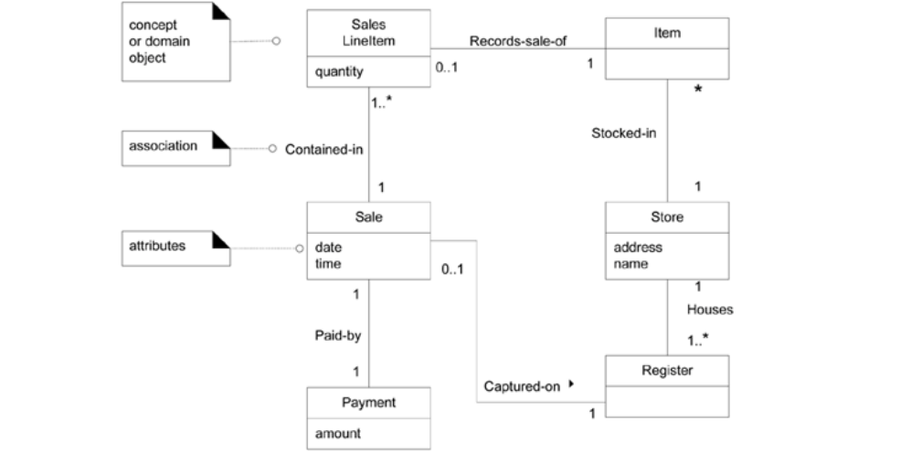
Partial Domain Model A Visual Dictionary

Slide 13
HOW TO CREATE A DOMAIN MODEL
Find the conceptual classes.
Draw them classes as UML class diagram.
Add associations and attributes.

Slide 14
WHAT IS A CONCEPTUAL CLASS? A real-world "thing" that is important to your system. Examples from a Store System: Item, Sale, Payment, Store, Register.

Slide 15
Strategies to Find Conceptual Classes:
Strategy 1 — Reuse Existing Models :
Modify Already-published Domain Models For Similar Systems (E.G., Inventory, Finance, Health)
Strategy 2 — Use A Category List Use A Checklist Of Common Categories Like Physical Objects, Transactions, Roles, And Match Them To Your System
Strategy 3 — Identify Noun Phrases Read Your Requirements And Extract All Nouns — Those Are Your Potential Classes

Slide 16
NOUN PHRASE EXAMPLE:
Sentence: "Customer visits store, picks item, makes payment at register“
Extracted Classes: Customer → Store → Item → Payment → Register

Slide 17
Method 2: Category List
The Fastest Way To Start A Domain Model Is To Match Your System Against A Standard Category Checklist.

Slide 18
Most Important Categories to Check:
Category | Real Example
Business Transactions | Sale, Payment, Reservation
Transaction Line Items | SalesLineItem
Product/Service | Item, Flight, Seat
Where is it recorded? | Register, Ledger
People/Roles involved | Cashier, Customer, Passenger
Place of transaction | Store, Airport
Physical objects | Item, Board, Airplane

Slide 19
Method 3: Noun Phrase Identification:
Read your use case story and highlight every noun — those are candidate classes.
Example from Process Sale use case:
"Customer arrives at POS checkout with goods. Cashier starts a sale, enters item identifier. System records sale line item, shows price and total. Customer pays, system handles payment, prints receipt."
Nouns Extracted = Candidate Classes: Customer, POS, Goods, Cashier, Sale, Item, Price, Total, Payment, Receipt, Accounting, Inventory
Warning: Not every noun becomes a class. Some are attributes, some are out of scope. Use judgment!

Slide 20
Case Study: POS Domain Model (Iteration 1)
After applying both methods, these classes were identified:
Final Class List: Sale, CashPayment, SalesLineItem, Item, Register, Ledger, Cashier, Customer, Store, ProductDescription, ProductCatalog
There is no single "correct" list — different modelers may find slightly different classes, but the important ones will always appear.

Slide 21
Golden Rules to Remember
Start with transactions — Sale, Payment, Reservation always come first
Every transaction has line items — find them next
Ask who, where, what — people, places, products related to the transaction
Nouns = candidates, not guaranteed classes
Some nouns are attributes (price, date) not classes
No perfect list exists — follow the strategy and similar results will emerge
Draw the diagram immediately — don't wait, sketch classes as you find them

Slide 22
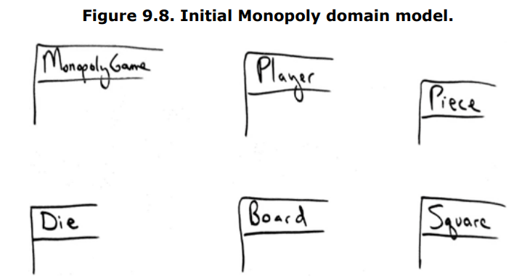
Guidelines : Agile Modeling — Sketching a Class Diagram
What is Agile Modeling Sketching?
when building a domain model, you don't need perfect diagrams — simple hand-drawn sketches work great, especially in early stages.
Key Observation from Figure 9.8
Look at the Monopoly diagram — notice the boxes are open on the bottom and right sides:

Slide 23
Why open sides? So you can easily add new attributes and details later without redrawing the whole box!
1. Sketch First, Perfect Later In Agile Modeling, start with rough hand-drawn class diagrams — don't waste time making them perfect too early.
2. Open Box Style Draw class boxes with the bottom and right sides open — this allows easy expansion as new elements are discovered.
3. Spread Out on Whiteboard In real practice, spread class boxes across the whiteboard with space between them this makes it easier to draw associations and add new classes.
4. Grow as You Learn The diagram evolves — as you discover new attributes, relationships, or classes, you simply extend the open boxes.
5. Agile = Flexible The goal is communication and thinking, not beautiful documentation. A rough sketch that helps the team understand is better than a perfect diagram that takes too long.

Slide 24
Should "Receipt" Be in the Domain Model? Core Idea: Not every real-world term needs to be a class — think before adding. Key Points: 1. Receipt = Duplicate Information Receipt only shows Sale + Payment data it adds no new information, so it's a candidate for exclusion. 2. Reason to EXCLUDE Receipt Any report that just repeats existing data does not deserve its own class in the domain model. 3. Reason to INCLUDE Receipt Receipt has a special business role — it gives the customer the legal right to return items.

Slide 25
Think like a Mapmaker ;Use Domain Model
Use the existing names in the territory.
For example, if developing a model for a library, name the customer a "Borrower" or "Patron“ the terms used by the library staff.
Exclude irrelevant or out-of-scope features.
For example, in the Monopoly domain model for iteration-1, cards (such as the "Get out of Jail Free" card) are not used, so don't show a Card in the model this iteration.

Slide 26
How to Model the Unreal World?
Some software systems are for domains that find very little analogy in natural or business domains; software for telecommunications is an example. Yet it is still possible to create a domain model in these domains. It requires a high degree of abstraction, stepping back from familiar non-OO designs, and listening carefully to the core vocabulary and concepts that domain experts use.
For example, here are candidate conceptual classes related to the domain of a telecommunication switch: Message, Connection, Port, Dialog, Route, Protocol.

Slide 27


A Common Mistake with Attributes vs. Classes
Perhaps the most common mistake when creating a domain model is to represent something as an attribute when it should have been a conceptual class. A rule of thumb to help prevent this mistake is
Guideline:
If we do not think of some conceptual class X as a number or text in the real world, X is probably a conceptual class, not an attribute.
In the real world, a store is not considered a number or text the term suggests a legal entity, an organization, and something that occupies space. Therefore, Store should be a conceptual class.
As another example, consider the domain of airline reservations. Should destination be an attribute of Flight, or a separate conceptual class Airport?
In the real world, a destination airport is not considered a number or text it is a massive thing that occupies space. Therefore, Airport should be a concept.

Slide 28
Description Classes
A description class stores shared information about many similar objects. it separates general details
from specific instances.
Why we use it
Real-world objects have:
Common data (shared)
Unique data
Example
Item (physical object) → serial number (unique)
ProductDescription → name, price (common)

Slide 29
When to Use Description Classes
Many objects share same attributes
System returns lists of similar items
You want to reduce duplication
Information is independent of instances
Problem Without It
Data repetition (redundancy)
Hard to update (same info in many places)
Inconsistency errors

Slide 30
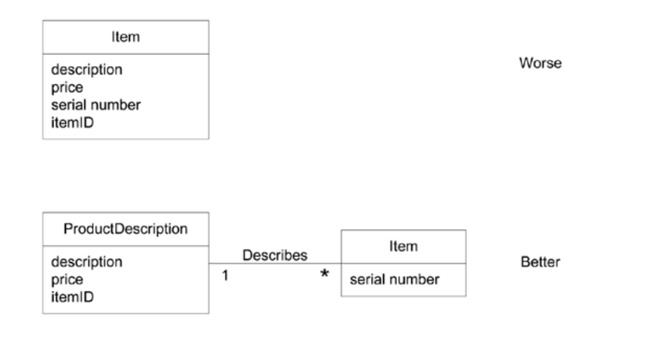
Example

Slide 31
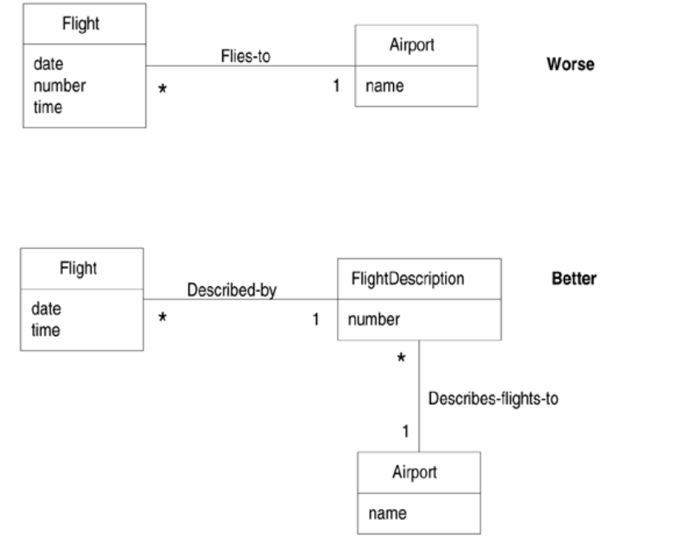
Example

Slide 32
Associations
Association is a relationship between two or more classes.Shows how objects are connected or interact with each other
When to Show an Association
When the relationship needs to be remembered or stored
When objects need to communicate or work together
Example
Student ↔ Course A student enrolls in a course
Customer ↔ Order A customer places an order
UML Notation
Represented by a simple line between classes

Slide 33
Roles and Multiplicity
In an association, each end is called a role. A role may include a name, multiplicity, and navigability. These help define how classes are connected.
Multiplicity is very important because it shows how many instances of one class can be related to another class.
Common multiplicity values include:
1 → exactly one
0..1 → zero or one
* → many
1..* → one or more
1..40 → a range
5 → exactly five

Slide 34
Multiple Associations
Sometimes, two classes can have multiple associations between them. For example, a Flight can have two relationships with Airport: flies-to and flies-from.
There are also common types of associations used in UML modeling, such as:
Transaction relationships (e.g., Payment and Sale)
Line items of a transaction (e.g., SalesLineItem and Sale)
Part-whole relationships (e.g., Wheel and Car)
Container relationships (e.g., Register and Drawer)
Description relationships (e.g., ProductDescription and Product)
Organizational relationships (e.g., Department and Store)

Slide 35
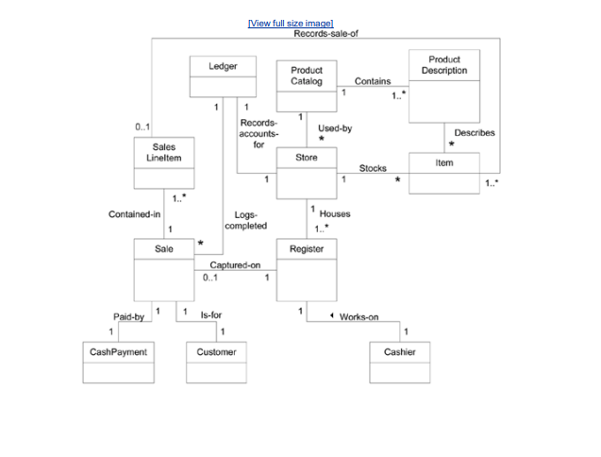
Associations in the Domain Models

Slide 36
ATTRIBUTES
Definition
An attribute is the data or value of an object.
Stores information in a class.
Based on system requirements
When to show attributes
Include only required attributes
based on use cases
system must remember this data
Examples:
sale → datetime
store → name, address

Slide 37
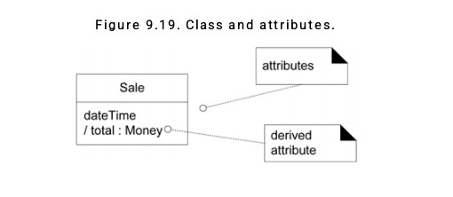
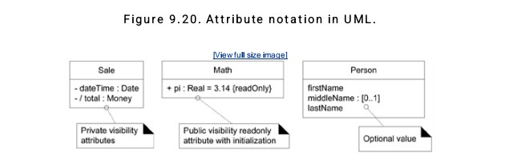
ATTRIBUTE NOTATION
Attributes are shown in the second compartment of the class box (see Figure 9.19). Their type and other information may optionally be shown.
More Notation
The full syntax for an attribute in the UML is:
visibility name : type multiplicity = default {property-string}
Some common examples are shown in Figure 9.20.

Slide 38
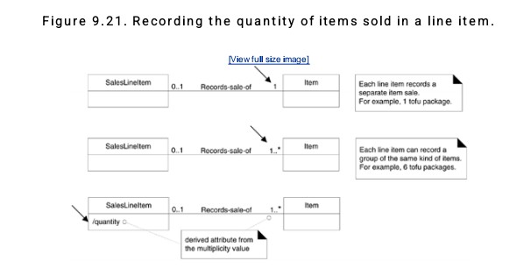
Derived Attributes Attribute Types
Calculated from other values
Not stored directly
Use "/" symbol
Example:
/total
quantity
Prefer simple data types:
Number, String, Boolean, Date
Data types = value-based (no identity)
Objects (like Person) have identity

Slide 39
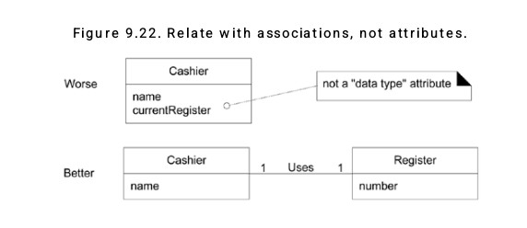
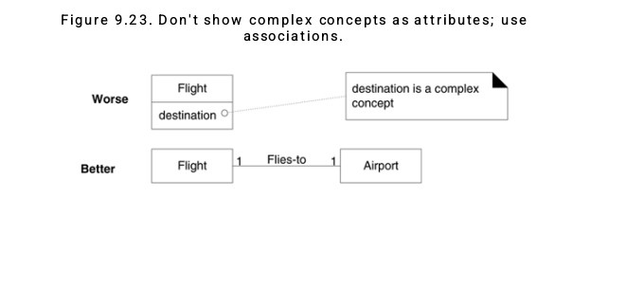
Associations vs Attributes
Important Rule
❌ Do not use complex objects as attributes
✔ Use associations instead
Examples:
Cashier → Register
Flight → Airport

Slide 40
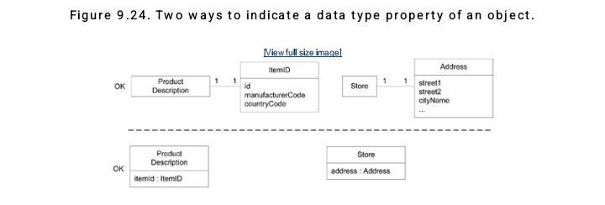
Data Type Classes & Guidelines
New Data Type Classes
Create new class if:
Value has multiple parts
Needs validation
Has its own attributes
Has units
Examples:
ItemID
Address
Money
Showing Data Types
Two ways:
Inside attribute
As separate class
Depends on importance

Slide 41
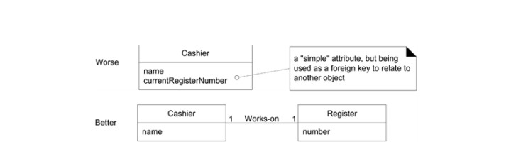
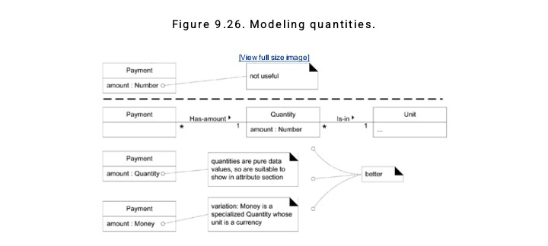
Special Guidelines
❌ No foreign keys as attributes
✔ Use associations
Quantities must include units
Price → Money
Weight → kg

Slide 42
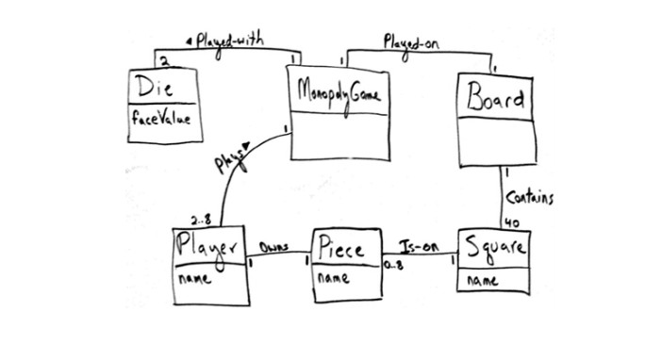
Example: Attributes in the Domain Models
Case Study: Monopoly
See Figure. The attributes chosen reflect the information requirements for this iteration the simplified Play Monopoly Game scenario of this iteration.
For example:
Die faceValue After rolling the dice, needed to calculate the distance of a move.
Square name To print the desired trace output.

Slide 43
Conclusion
No single correct domain model
It is a simple representation of reality
Used to understand the system
Helps communication
Shows key concepts and relationships

